Slide 1

Swift language

Slide 2
Swift language?!
Apple introduced Swift, an entirely new language for the development of iOS and OS X (now called macOS) applications in 2014
Another goal of Swift is to be a suitable replacement for the C family of languages (C, C++, and Objective-C). That means Swift has to be fast.
Swift gives you safety and performance all in a clean, modern syntax. The language is quite expressive; developers can write code that feels natural. This feature makes Swift a joy to write and easy to read, which makes it great for collaborating on larger projects
Swift gives you safety and performance all in a clean, modern syntax. The language is quite expressive; developers can write code that feels natural. This feature makes Swift a joy to write and easy to read, which makes it great for collaborating on larger projects

Slide 3
Swift language?!
Apple hopes that developers will use Swift to write apps for a variety of mobile and desktop platforms and to develop back-end web applications as well.
Swift is intended to become a mainstream programming language that is the best solution for writing a variety of applications on a variety of systems

Slide 4
Necessary Hardware and Software
To build and run the applications, you will need a Mac running macOS El Capitan
You will also need to install Xcode, Apple’s integrated development environment (IDE), which is available on the App Store.
Xcode includes the Swift compiler as well as other development tools

Slide 5
Introduction
Computers can be programmed
Designed to do any job that a program tells them to
Program: set of instructions that a computer follows to perform a task
Commonly referred to as Software
Programmer: person who can design, create, and test computer programs
Also known as software developer

Slide 6
Software
Everything the computer does is controlled by software
General categories:
Application software
System software
Application software: programs that make computer useful for every-day tasks
Examples: word processing, email, games, and Web browsers

Slide 7
Software (cont’d.)
System software: programs that control and manage basic operations of a computer
Operating system: controls operations of hardware components
Utility Program: performs specific task to enhance computer operation or safeguard data
Software development tools: used to create, modify, and test software programs

Slide 8
How Computers Store Data
All data in a computer is stored in sequences of 0s and 1s
Byte: just enough memory to store letter or small number
Divided into eight bits
Bit: electrical component that can hold positive or negative charge, like on/off switch
The on/off pattern of bits in a byte represents data stored in the byte

Slide 9
Storing Numbers
Bit represents two values, 0 and 1
Computers use binary numbering system
Position of digit j is assigned the value 2^{j-1}
To determine value of binary number sum position values of the 1s
Byte size limits are 0 and 255
0 = all bits off; 255 = all bits on
To store larger number, use several bytes

Slide 10
Compilers and Interpreters
Programs written in high-level languages must be translated into machine language to be executed
Compiler: translates high-level language program into separate machine language program
Machine language program can be executed at any time

Slide 11
Compilers and Interpreters (cont’d.)
Interpreter: translates and executes instructions in high-level language program
Used by Python language
Interprets one instruction at a time
No separate machine language program
Source code: statements written by programmer
Syntax error: prevents code from being translated

Slide 12
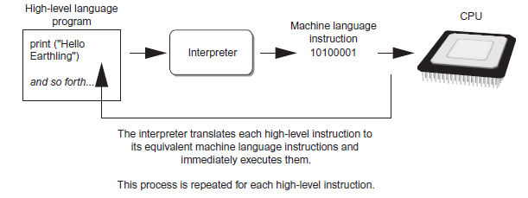
Compilers and Interpreters (cont’d.)
Figure 1-19 Executing a high-level program with an interpreter

Slide 13


Slide 14
Playgrounds
Playgrounds are interactive work environments that let us write code and see the results immediately as changes are made to the code

Slide 15
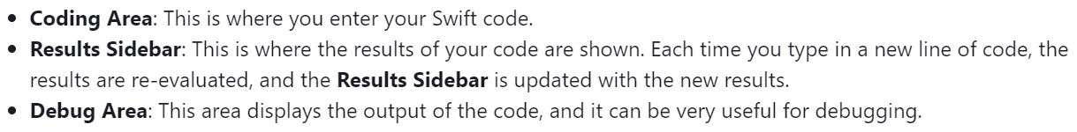
Playground sections!?

Slide 16
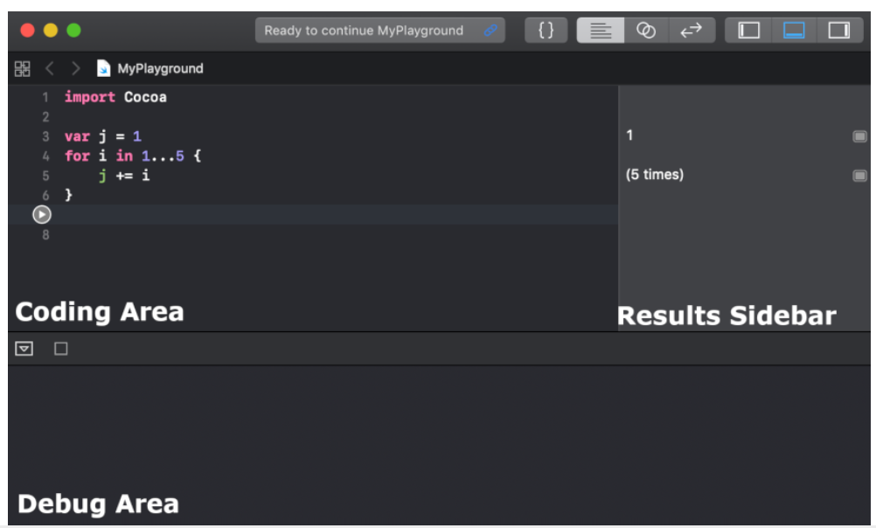
Playground sections!?

Slide 17
Xcode shortcuts to boost your iOS development
https://medium.com/swift-india/awesome-xcode-shortcuts-to-boost-your-ios-development-ad8fa6ec2ac8
https://medium.com/@dubemike/8-power-xcode-shortcuts-every-developer-should-know-e8ab9f77dcac

Slide 18
Comments !?
We can still use the double slash // for single-line comments
/** and */ for multiline comments;
if we want to use the comments to also document our code, we need to use the triple slash (///) or multiline comment block

Slide 19
Comments
Use comments to include non executable text in your code, as a note or reminder to yourself
Comments are ignored by the Swift compiler when your code is compiled
Single-line comments begin with two forward-slashes (//)
// This is a comment
Multiline comments start with a forward-slash followed by an asterisk (/*) and end with an asterisk followed by a forward-slash (*/)
/* This is also a comment
but is written over multiple lines. */

Slide 20

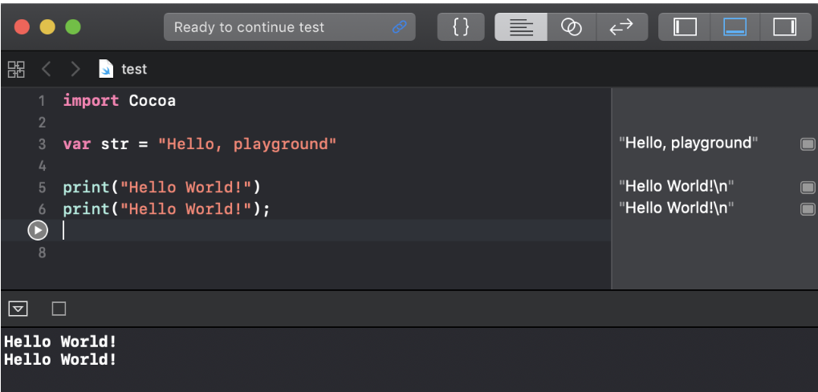
You may have noticed, from the code samples so far, that we are not using semicolons at the end of lines. The semicolons are optional in Swift
For style purposes, it is strongly recommended that you do not use semicolons in your Swift code. If you are really set on using semicolons, be consistent and use them on every line of code; however, there is no warning if you forget them.

Slide 21

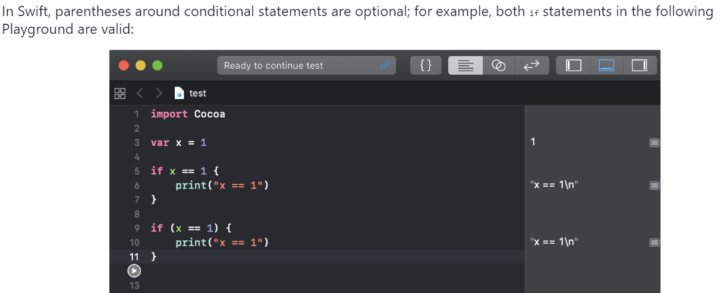

Slide 22
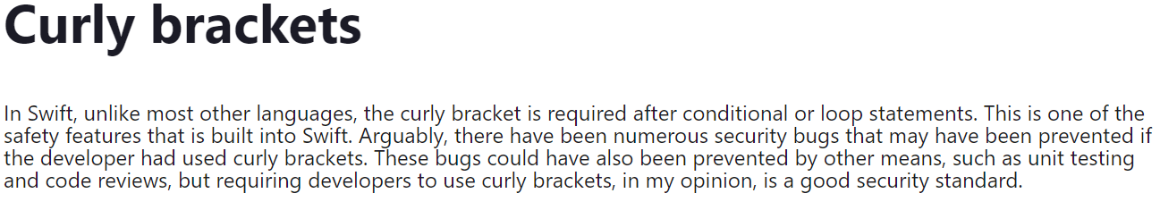
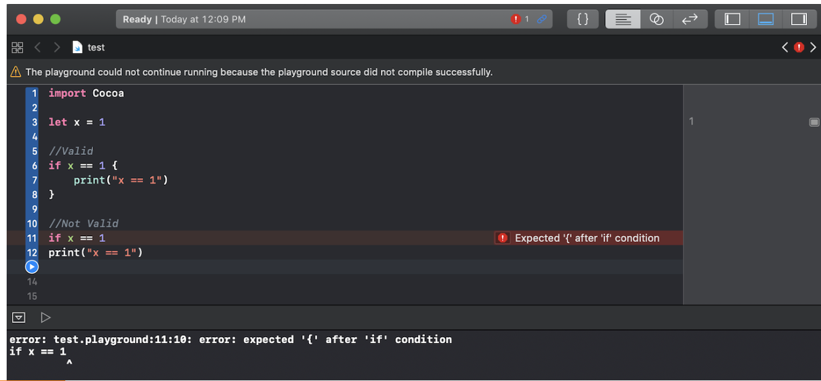

Slide 23
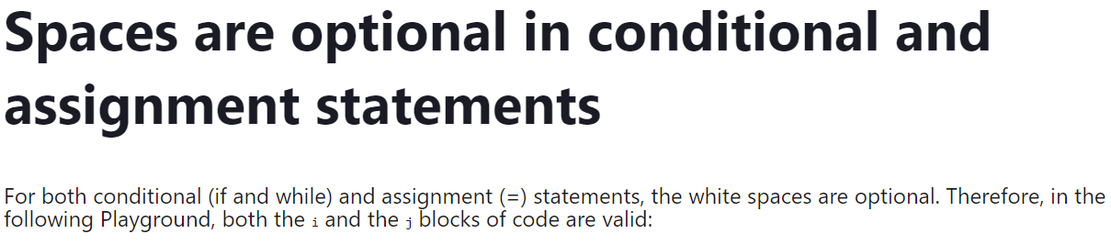
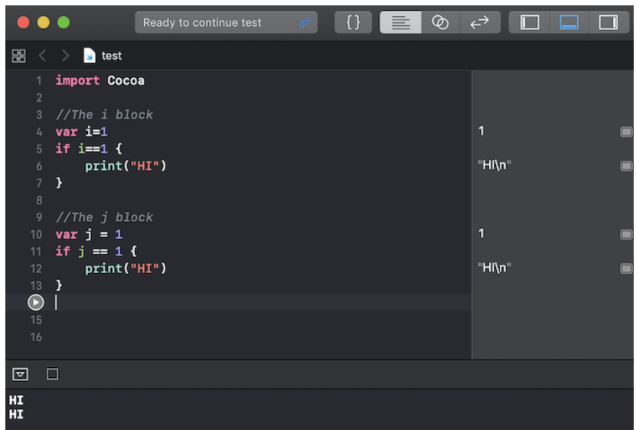

Slide 24
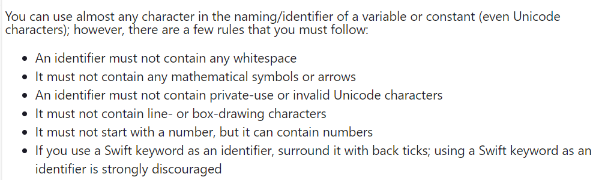
Rules for assigning name for variables & constants

Slide 25
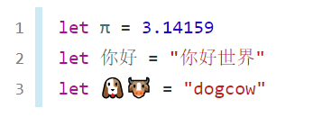
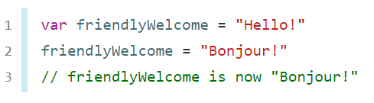
Rules for assigning name for variables & constants

Slide 26
Constants & Variables ???!!!!
Constants and variables associate a name (such as maximumNumberOfLoginAttempts or welcomeMessage) with a value of a particular type
Constants and variables must be declared before they’re used
Constants are good for defining values that you know will never change like the temperature that water freezes at or the speed of light

Slide 27
Declaring Constants
You declare constants with the let keyword
let maximumNumberOfLoginAttempts = 10
let freezingTemperatureOfWaterCelsius = 0
let speedOfLightKmSec = 300000

Slide 28
Define variables
To define a variable, you use the var keyword
var currentTemperature = 22
var currentSpeed = 55
var currentLoginAttempt = 0

Slide 29
Can we declare multiple constants or variables in a single line?
var x = 0.0, y = 0.0, z = 0.0
var currentTemperture = 22, currentSpeed = 55
let freezingTempertureOfWaterCelsius = 0, speedOfLightKmSec = 300000

Slide 30
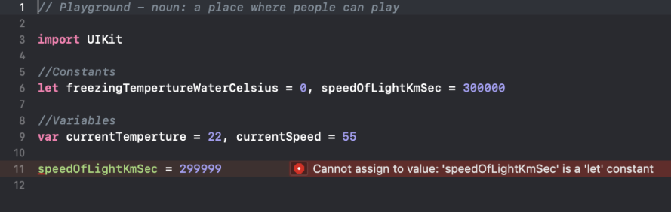

Slide 31
Int type
In most cases, you don’t need to pick a specific size of integer to use in your code.
Swift provides an additional integer type, Int, which has the same size as the current platform’s native word size:
On a 32-bit platform, Int is the same size as Int32.
On a 64-bit platform, Int is the same size as Int64.
Even on 32-bit platforms, Int can store any value between -2,147,483,648 and 2,147,483,647
Even on 64-bit platforms, Int can store any value between -9,223,372,036,854,775,808 to 9,223,372,036,854,775,807

Slide 32
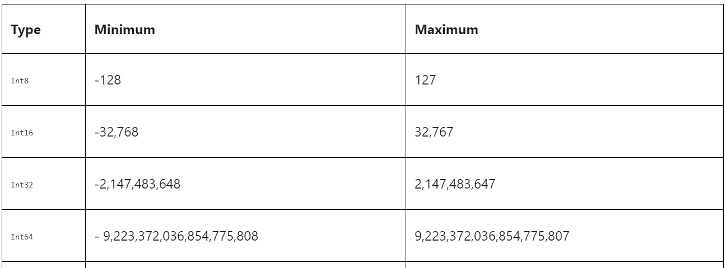
Integer types

Slide 33
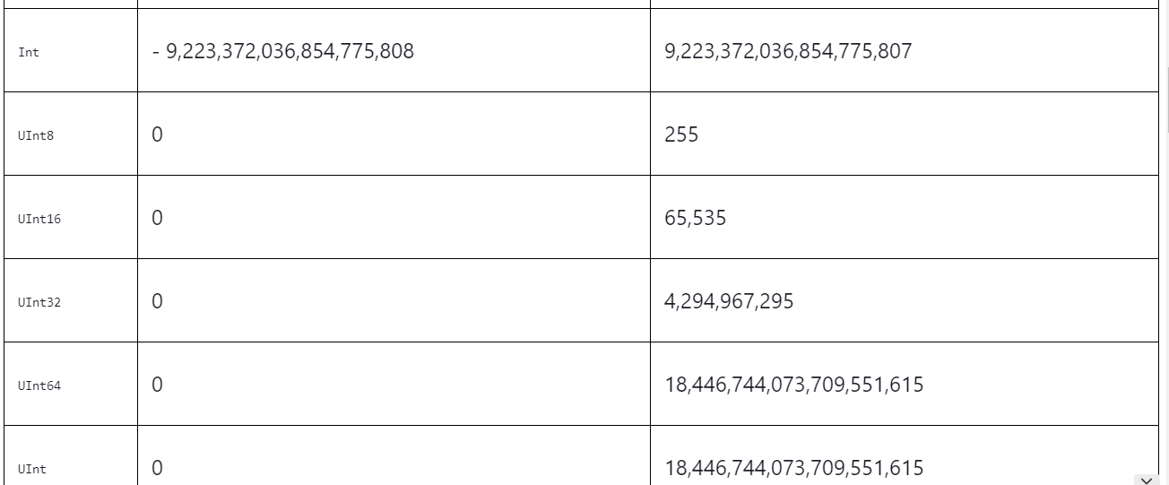
Integer types

Slide 34
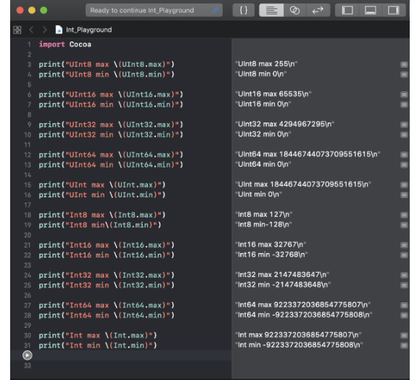

Slide 35
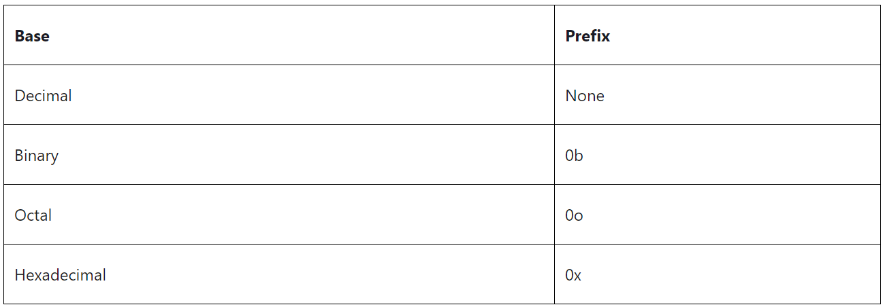

Slide 36
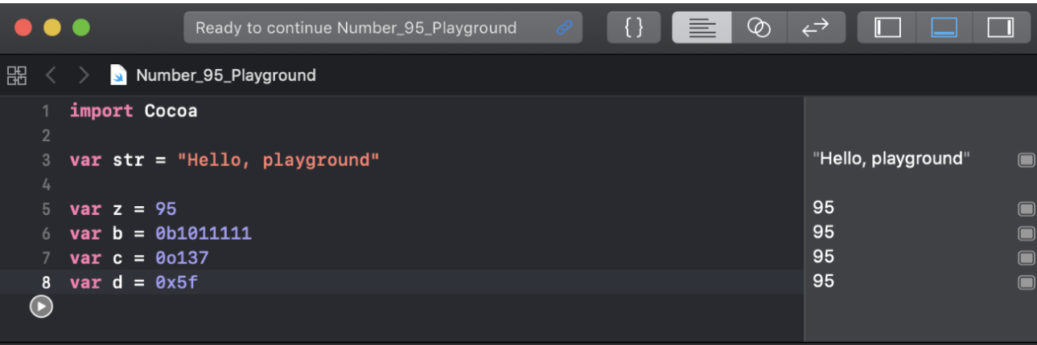

Slide 37
Arbitrary underscores
Swift also allows us to insert arbitrary underscores in our numeric literals.
This can improve the readability of our code without changing the underlying value
The Swift compiler will ignore these underscores and interpret this value as if the underscores were not there
let speedOfLightKmSec = 300_000

Slide 38
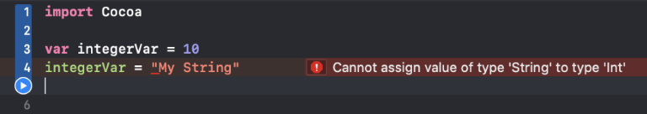
Error?!!

Slide 39
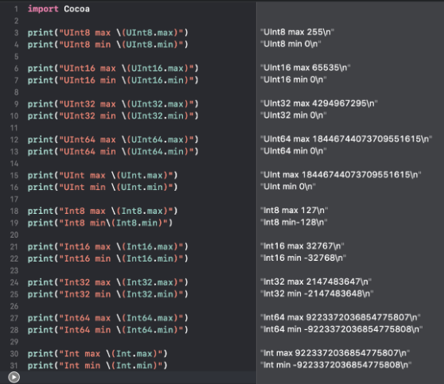

Slide 40
Floating-Point Numbers
Floating-point numbers are numbers with a fractional component, such as 3.14159, 0.1, and -273.15
Floating-point types can represent a much wider range of values than integer types, and can store numbers that are much larger or smaller than can be stored in an Int

Slide 41
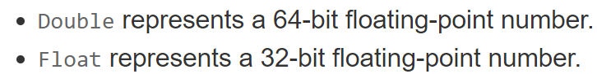
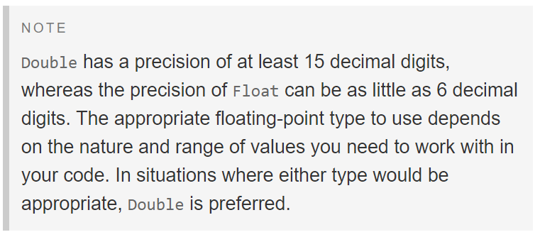
Floating-Point Numbers types

Slide 42
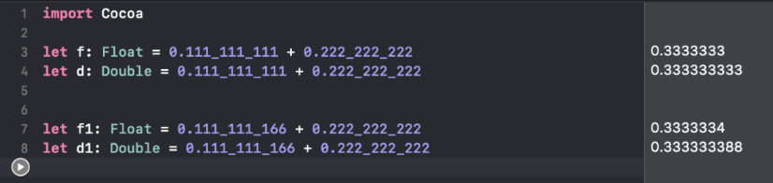
Floating-point and Double values

Slide 43
Type Annotations???
You can provide a type annotation when you declare a constant or variable, to be clear about the kind of values the constant or variable can store
Write a type annotation by placing a colon after the constant or variable name, followed by a space, followed by the name of the type to use
var welcomeMessage: String
var red, green, blue: Double

Slide 44
Type inference
Type inference allows us to omit the variable type when the variable is defined with an initial value
var myInt = 1 // Integer type
var x = 3.14 // Double type
var y = "Hello" // String type
var z = true // Boolean type

Slide 45
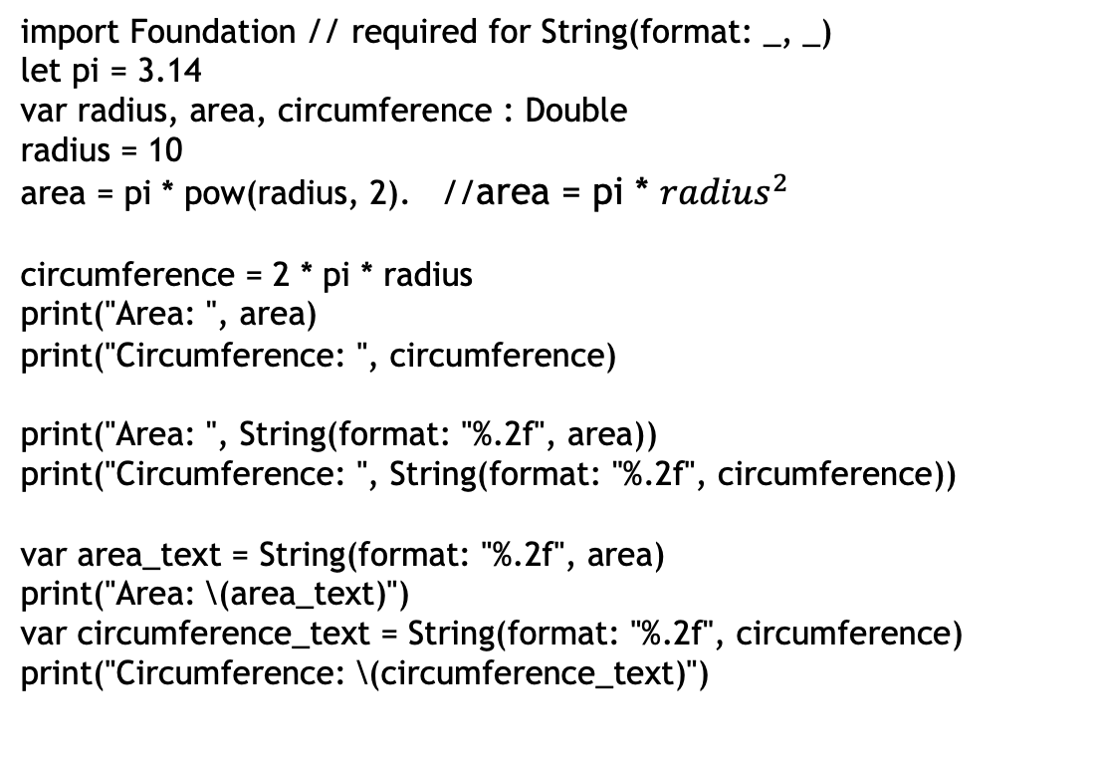
import Foundation // required for String(format: _, _)
let pi = 3.14
var radius, area, circumference : Double
radius = 10
area = pi * pow(radius, 2). //area = pi * ${radius}^{2}$
circumference = 2 * pi * radius
print("Area: ", area)
print("Circumference: ", circumference)
print("Area: ", String(format: "%.2f", area))
print("Circumference: ", String(format: "%.2f", circumference))
var area_text = String(format: "%.2f", area)
print("Area: \(area_text)")
var circumference_text = String(format: "%.2f", circumference)
print("Circumference: \(circumference_text)")

